Slide 1
Association Rule Mining:

Slide 2
Module 4 Syllabus
Basic concepts - Frequent itemset mining methods - Apriori algorithm, FPattern growth (FP growth) approach for mining frequent itemsets,
Mining frequent itemsets using vertical data format,
Mining closed and max patterns - Pattern mining in multilevel and multidimensional space – Constraint based Frequent pattern mining - Mining
High-Dimensional Data and Colossal Patterns.

Slide 3
Association rule Mining
It is a type of unsupervised learning methods that tests for the dependence of one data element on another data element and create appropriately so that it can be more effective. It tries to discover some interesting relations or relations among the variables of the dataset. It depends on several rules to find interesting relations between variables in the database.
The association rule learning/Mining is the important technique of machine learning, and it is working in Market Basket analysis, Web usage mining, continuous production, etc. In market basket analysis, it is effectively used by several big retailers to find the relations among items.

Slide 4
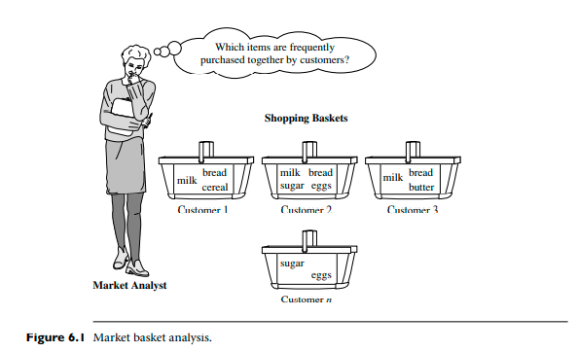
Association Rule Mining:
Market Basket Analysis:

Slide 5
Association Rule Mining/ Frequent itemset generations
Rules that satisfy both a minimum support threshold (min sup) and a minimum confidence threshold (min conf ) are called strong. By convention, we write support and confidence values between 0% and 100%, rather than 0 to 1.0. A set of items is referred to as an itemset.
An itemset that contains k items is a k-itemset.
The set {computer, antivirus software} is a 2-itemset.
The occurrence frequency of an itemset is the number of transactions that contain the itemset. This is also known as the frequency, support count, or count of the itemset.

Slide 6
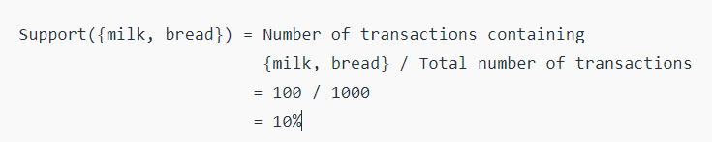
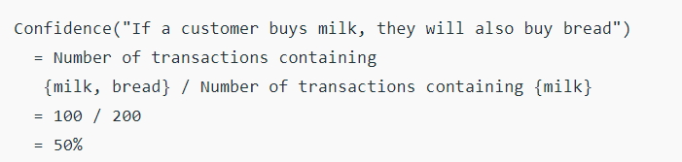
Support and confidence Example
Support(A=>B) =P(A∪B)
Confidence(A=>B) =P(B|A)

Slide 7
Association Rule Mining or Frequent Itemset Mining
Because the second step is much less costly than the first, the overall performance of mining association rules is determined by the first step. A major challenge in mining frequent itemsets from a large data set is the fact that such mining often generates a huge number of itemsets satisfying the minimum support (min sup) threshold, especially when min sup is set low. This is because if an itemset is frequent, each of its subsets is frequent as well.
For discovering interesting relationships between variables in large databases.
Useful for analysing customer behaviour.
There are basically two types of algorithms to find frequent pattern's in data set:
Apriori algorithm
FP Growth

Slide 8
Association Rule Mining:
In general, association rule mining can be viewed as a two-step process:
Find all frequent itemsets: By definition, each of these itemsets will occur at least as frequently as a predetermined minimum support count, min sup.
2. Generate strong association rules from the frequent itemsets: By definition, these rules must satisfy minimum support and minimum confidence.

Slide 9
TRANSACTIONS | ONION | POTATO | BURGER | MILK | COKE_BUY
T1 | 1 | 1 | 1 | 0 | 0
T2 | 0 | 1 | 1 | 1 | 0
T3 | 0 | 0 | 0 | 1 | 1
T4 | 1 | 1 | 0 | 1 | 0
T5 | 1 | 1 | 1 | 0 | 1
T6 | 1 | 1 | 1 | 1 | 0
Apriori Algorithm
DATA SET D
SUPPORT COUNT = 3
C 1
L 1
C 2
Transactions | Items
T1 | OPB
T2 | PBM
T3 | MC
T4 | OPM
T5 | OPBC
T6 | OPBM
Items | Supp.
{O} | 4
{P} | 5
{B} | 4
{M} | 4
{C} | 2
Items | Supp.
{OP} | 4
{OB} | 3
{OM} | 2
{PB} | 4
{PM} | 3
{BM} | 2
Items | Supp.
{O} | 4
{P} | 5
{B} | 4
{M} | 4
SCAN D
SCAN D
C 3
C 3
L 2
L 3
Item set | Supp.
{OPB} | 3
{OPM} | 2
{OBM} | 1
{BPM} | 2
Item set
{OPB}
{OPM}
{OBM}
{BPM}
Item set | SUPP.
{OP} | 4
{OB} | 3
{PB} | 4
{PM} | 3
Item set
{OPB}
SCAN D
Therefore Frequent Item Set = Onion, Potato and Burger

Slide 10
Rule generation:
Assume support is 50% and confidence is 50%
All the combinations of all three:
If Onion and potato then burger (conf=3/4 ie 75%)
If onion and burger then potato ( conf=3/4 ie. 75%)
If potato and burger then onion (conf=)
If burger then Onion and potato (conf=)
If potato then burger and onion (conf=)
If onion then burger and potato (conf=)
We will choose only those rules which have confidence as per predefined min confidence
Frequent Item Set = Onion, Potato and Burger

Slide 11
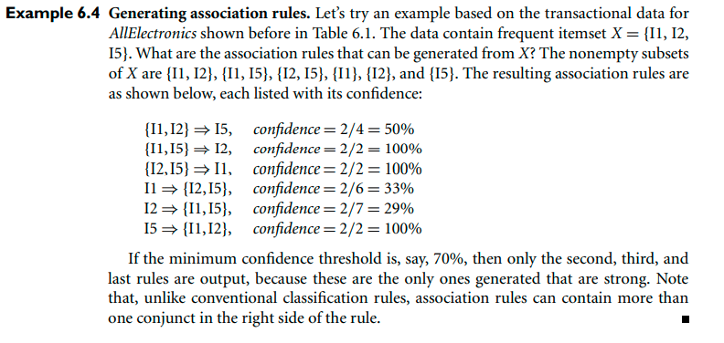
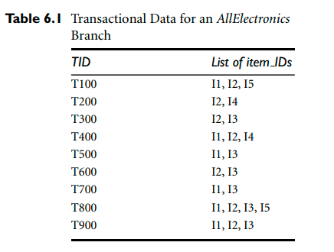
Another example
Reference: Han and kamber book pg: 250

Slide 12
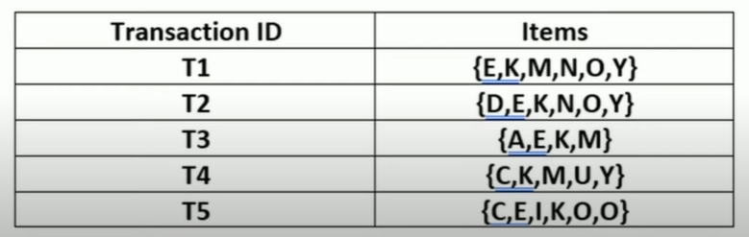
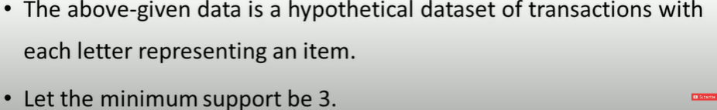
FP Growth

Slide 13
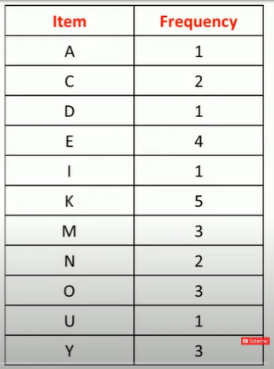
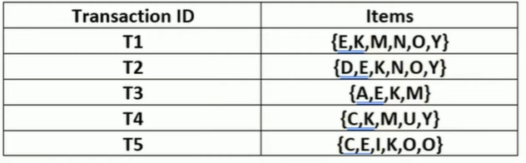
The frequency of each individual item is computed as

Slide 14
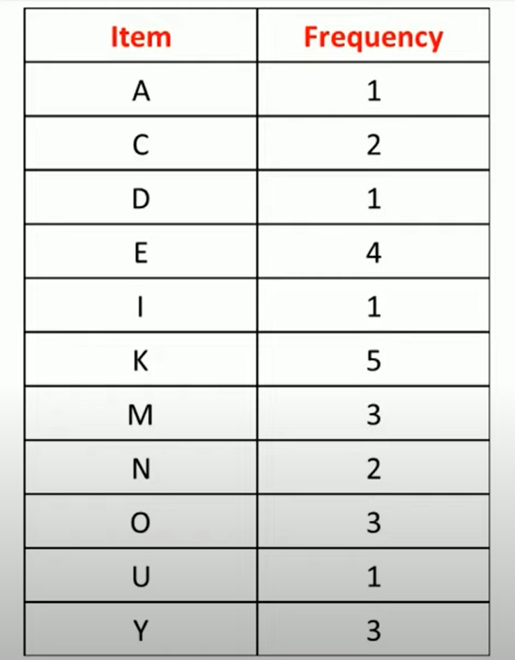
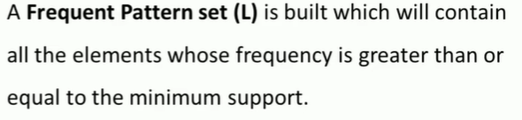
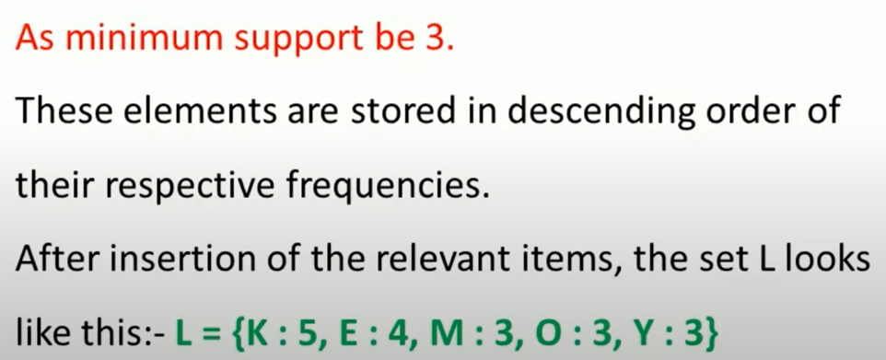
FP Growth

Slide 15
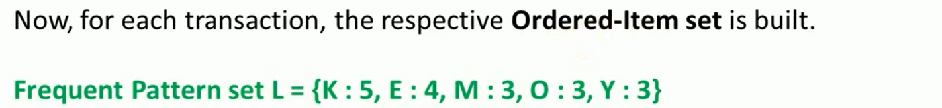
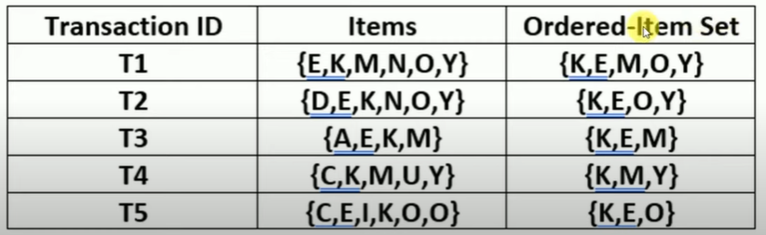
FP Growth

Slide 16
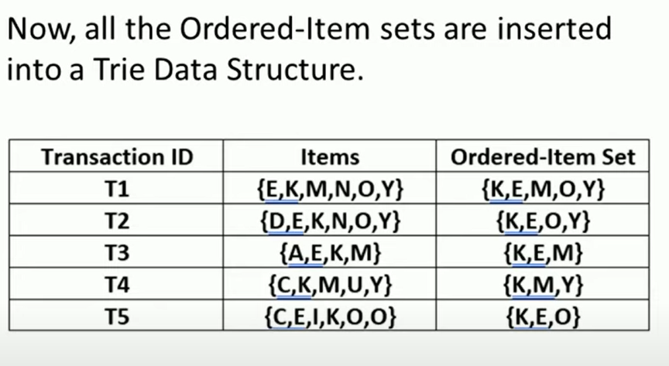
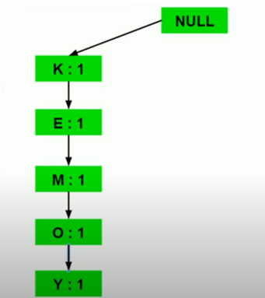
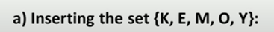
FP Growth

Slide 17
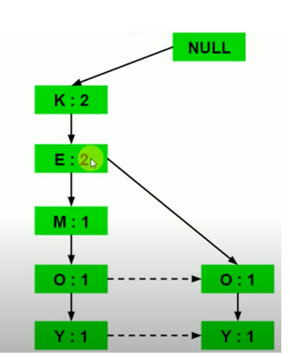

FP Growth

Slide 18
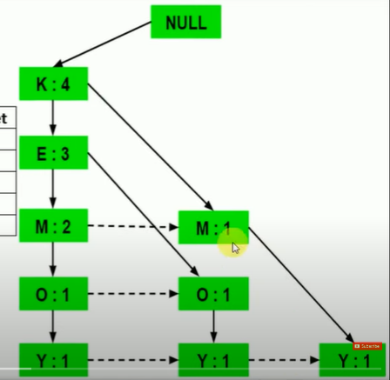
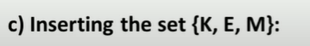
FP Growth

Slide 19
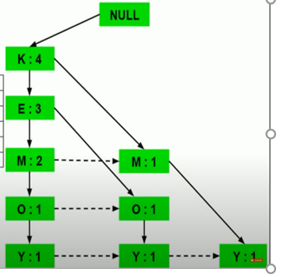

FP Growth

Slide 20
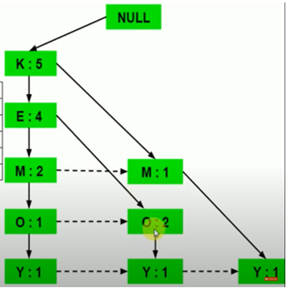

FP Growth

Slide 21
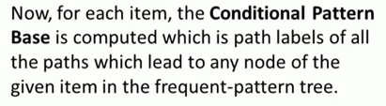
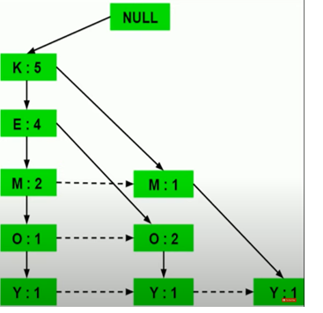
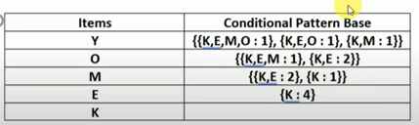
FP Growth

Slide 22
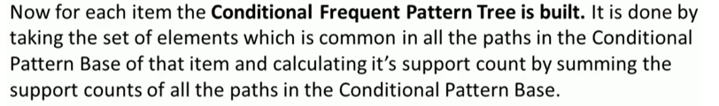
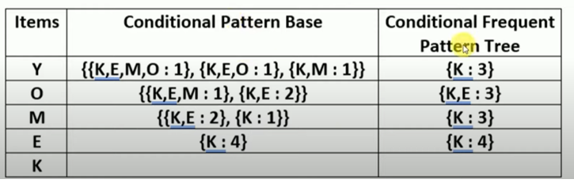
FP Growth

Slide 23
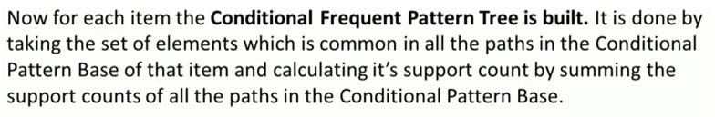
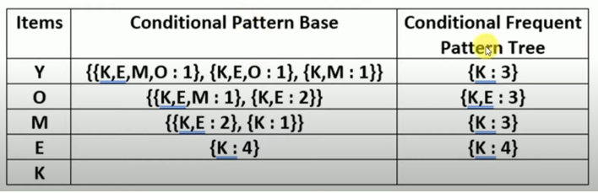
FP Growth

Slide 24
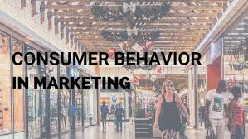
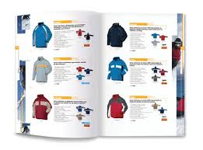

Applications of Association Rule
Items purchased on a credit card, such as rental cars and hotel rooms, support insight into the following product that customer are likely to buy.
Optional services purchased by tele-connection users (call waiting, call forwarding, DSL, speed call, etc.) support decide how to bundle these functions to maximize revenue.
Banking services used by retail users (money industry accounts, CDs, investment services, car loans, etc.) recognize users likely to needed other services.
Unusual group of insurance claims can be an expression of fraud and can spark higher investigation.
Medical patient histories can supports expressions of likely complications based on definite set of treatments.

Slide 25
Thank You

